Slide 1
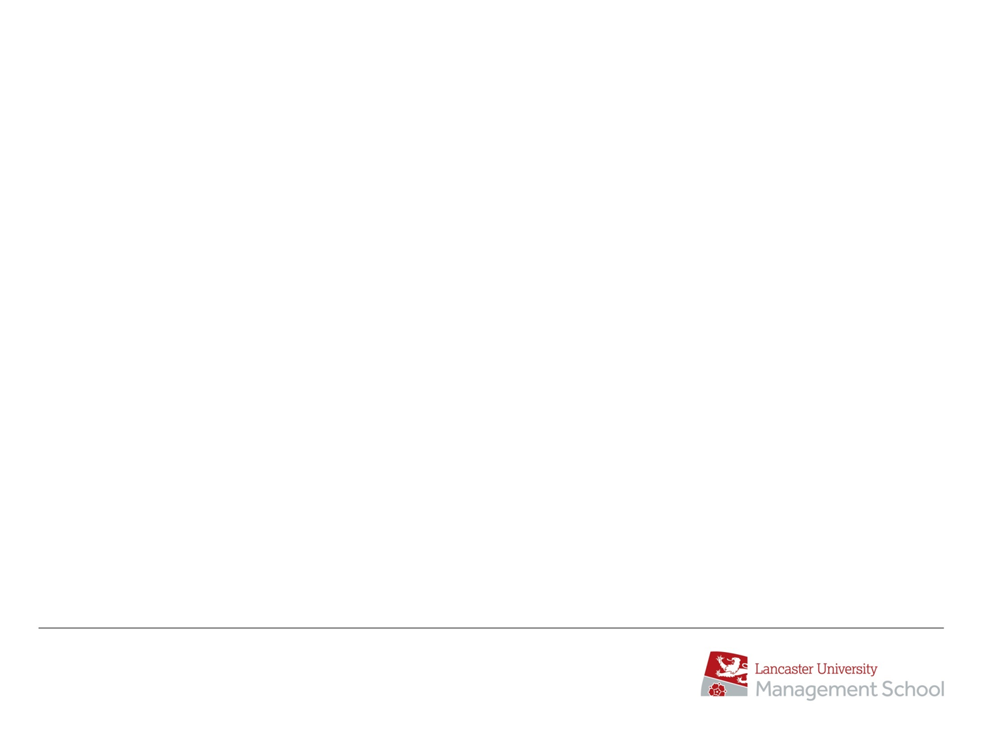


AcF 304 Financial Markets – Week 18 Commercial Awareness
Session Code: 225350
Notes:
If this PowerPoint presentation contains mathematical equations, you may need to check that your computer has the following installed:
1) MathType Plugin
2) Math Player (free versions available)
3) NVDA Reader (free versions available)

Slide 2
Week 12
Interest rates / bond yields up / bond prices down
Equity prices down
Why inflation bad for stock market (and bonds)
How the FED makes decision and communicates
Market language – Dovish & Hawkish
Inflation up
NASDAQ fell more than S&P 500
Classic portfolio theory broken (2022)
End 2023 Fed ‘pivoted’
Session Code:
225350

Slide 3
Week 14 Week 14
Non-Farm Payroll economic data release and affect on financial markets
Debt/GDP ratios - focus on Japan
GameStop +8000%
..including Payment For Order Flow

Slide 4
Week 16
Fixed Income
Corporate Bond Liquidity Problem

Slide 5
Week 16 Summary
Market Participants
FI Asset Classes
Demands of Buy Side
Electronic Trading Platforms
Corporate Bond Liquidity Challenges in the market

Slide 6
Q Why is there a Corporate bond Liquidity Problem that didn’t exist before the 2008 financial crisis?
Corporate bonds > More instruments than stocks/FX– e.g. Toyota
Match buyers and Sellers? Banks need to hold on to Corp Inventory > Requires Capital.
Since 2008 banks have less capital & Basle 3 Reg means capital requirement has gone up.
Banks can’t hold endless amount Corp Bonds so limits trading bonds – Dealer 2 Client model is broken
All-to-All the solution?

Slide 7
What is the Yen Carry Trade?
Japan first country in world to reach zero interest rates (circa 20 years ago)
US interest rates were 6.5% in 2000
By holding their savings in different currency = earn vastly more interest
Most high street banks in Japan offered such foreign currency deposit accounts
The selling of Yen kept the currency weak (decline GBP/JPY 150 to 250 from 2000 to 2007)

Slide 8
What is the ‘Yen Carry’ Trade?
In the wake of 2008 financial crisis the Yen soared above Yen 80 to $ and Yen 120 to Pound
Wiping of years of accumulated interest and capital losses for many
Japanese banks still offer foreign currency deposits.

Slide 9
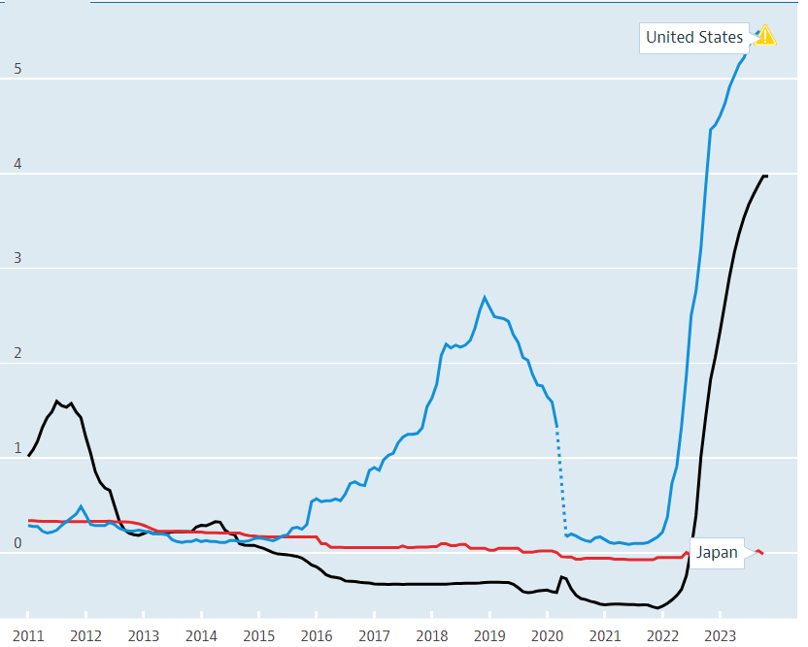
In theory the ‘Yen Carry’ Trade exists today?

Slide 10
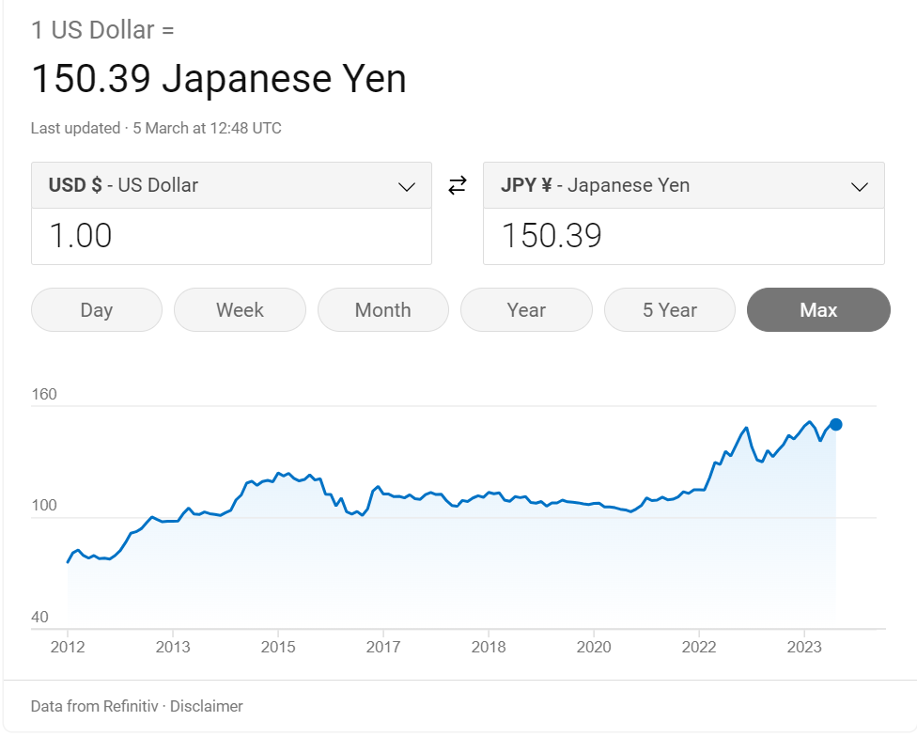
And the Yen has been weak which helps the trade…

Slide 11
TODAY
US 10-year bond at AcF 304 start – 3.94% YTM
US 10-year bond at AcF 304 end – 4.21% YTM
US NFP 1.30 PM today !! Forecast +200K

Slide 12
AcF 304 Financial Markets – Commercial Awareness HOPE YOU ENJOYED!!!
Session Code: 225350
Notes:
If this PowerPoint presentation contains mathematical equations, you may need to check that your computer has the following installed:
1) MathType Plugin
2) Math Player (free versions available)
3) NVDA Reader (free versions available)

